Slide 1
Project Assignment – Regression Analysis
David Lienkamp, Sevval Sagir, Raphael Sommer

Slide 2
Exercise & Aim
Given:
Car data of 52 models (different parameters like Power, Weight, etc.)
To predict:
Missing car data of 5 models (Acceleration, Max. Speed, Fuel Consumption & Price)

Slide 3
General Methodology
Choose continous/categorical predictors
Apply common knowledge, research
Minitab’s “Best Subset” feature (to get a hint on which parameters could potentially give a good R²-value)
Assess and adapt feasible p- and VIF-values (p < 0.05, VIF < 10)
Transform/create predictors (apply common knowledge by e.g. creating ratios)
Standardize predictors (subtract the mean, divide by standard deviation)
Assess and adapt residual plots
Normal propability plot: Remove obvious outliers
Versus fits patterns: Create interaction terms (!! standardization necessary due to high VIF-values)
Assess and improve R²-value (if necessary)
Apply Box-Cox transformation
Assess predictions if they are logical
If not, redo process steps 1-4

Slide 4
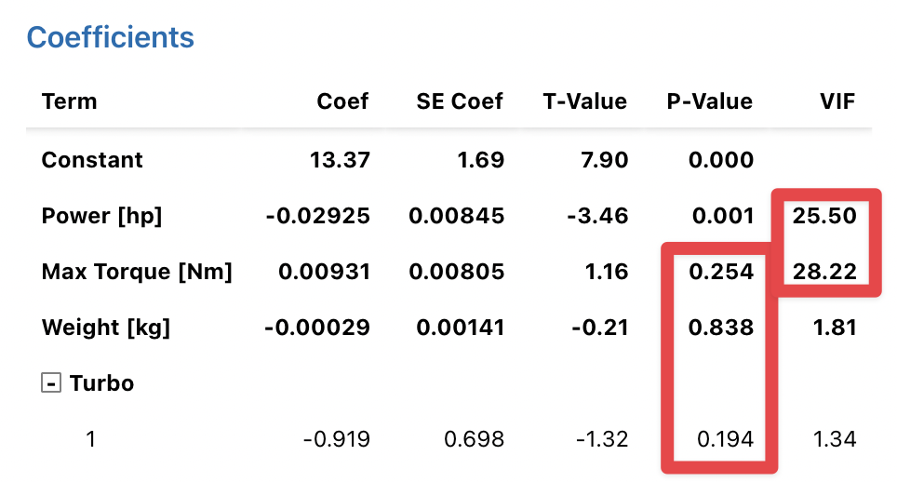
Acceleration – Methodology
Common knowledge:
Power, Weight, Max Torque & Turbo
Create common knowledge ratios: hp/kg (Power/Weight ratio) & RPM (Hp = Nm * RPM / 5252)
Standardize predictors
Create interaction term

Slide 5
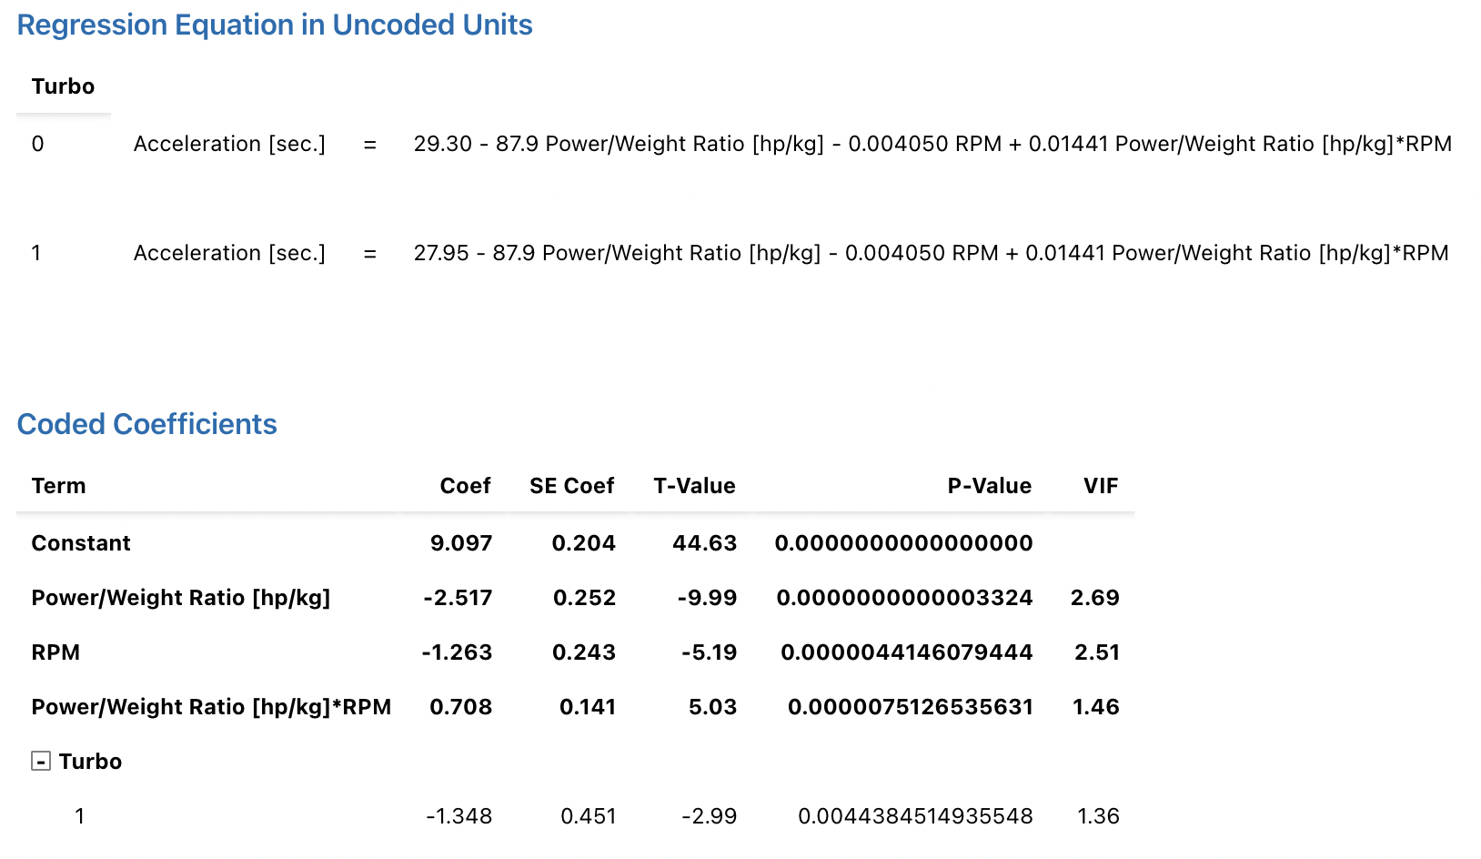
Regression Model – Acceleration (1)

Slide 6
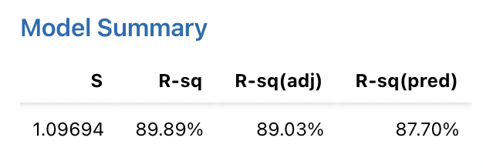
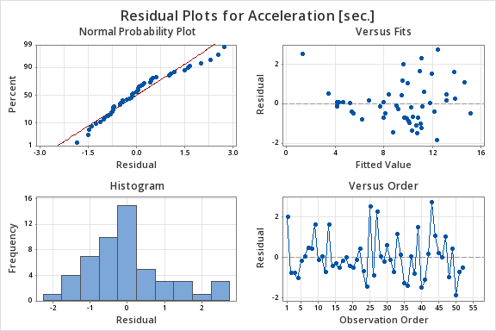
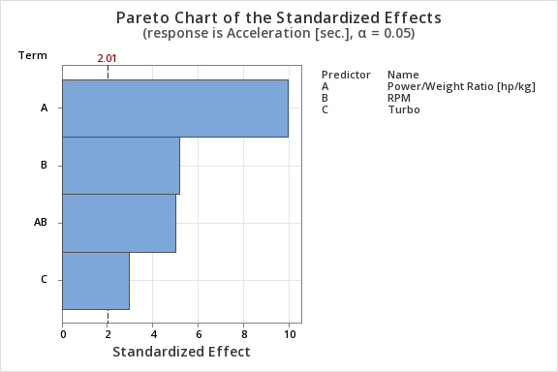
Regression Model – Acceleration (2)

Slide 7
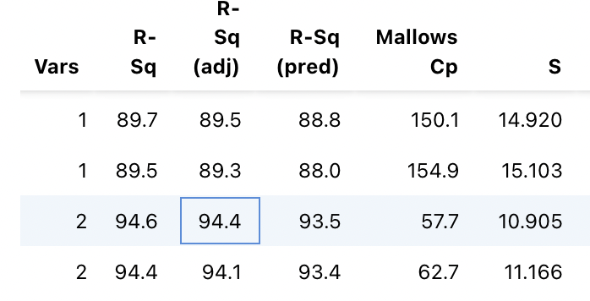
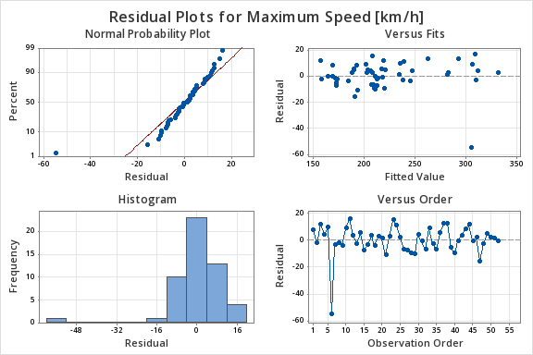
Maximum Speed – Methodology
Minitab’s Best subset with just 2 predictors:
Power, Acceleration
Remove outlier

Slide 8
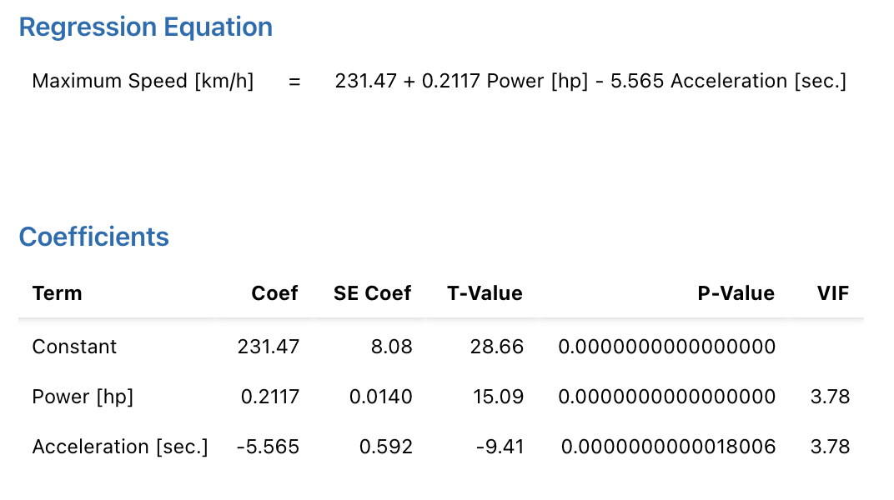
Regression Model – Max. Speed (1)

Slide 9
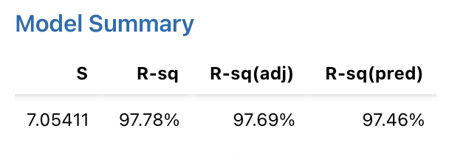
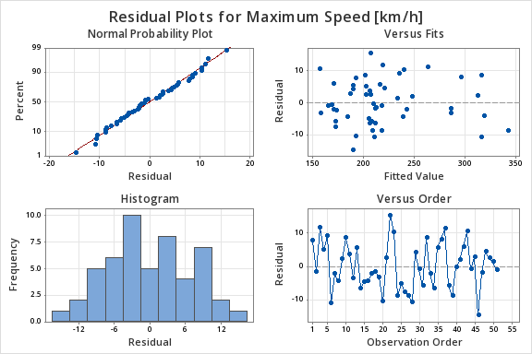
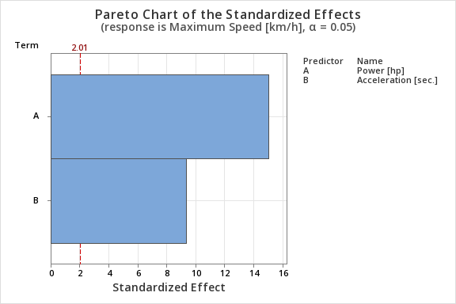
Regression Model – Max. Speed (2)

Slide 10
Fuel Consumption – Methodology
Common knowledge + Minitab’s Best Subset:
Power, Weight + Cylinders ➔ Power/Weight Ratio, Cylinders
No “issues”

Slide 11
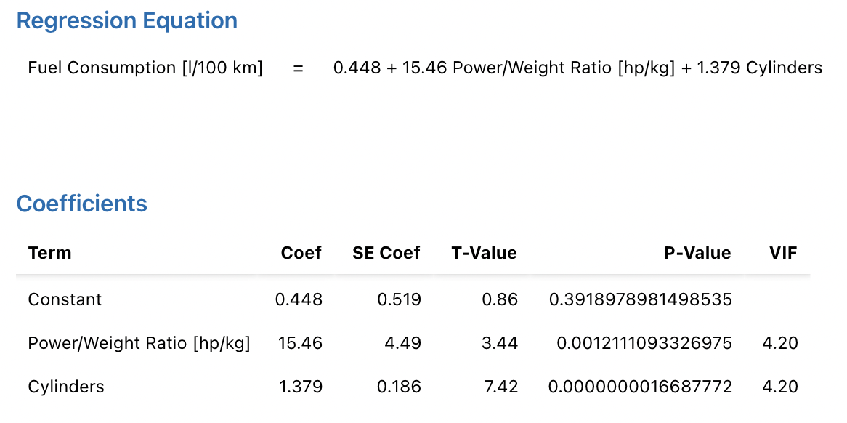
Regression Model – Fuel Cons. (1)

Slide 12
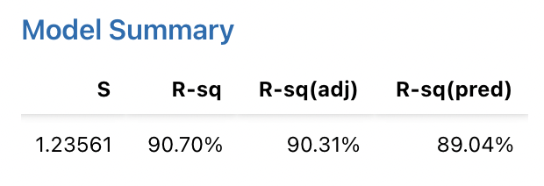
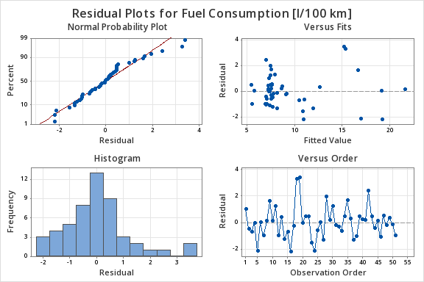
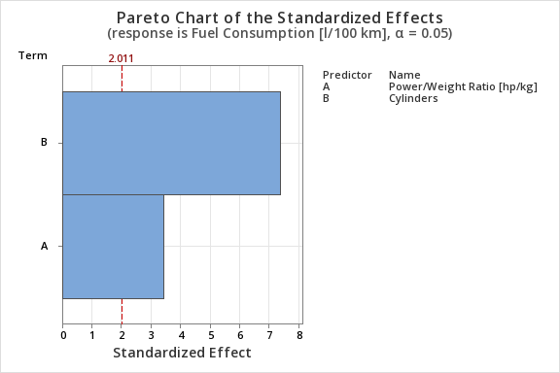
Regression Model – Fuel Cons. (2)

Slide 13
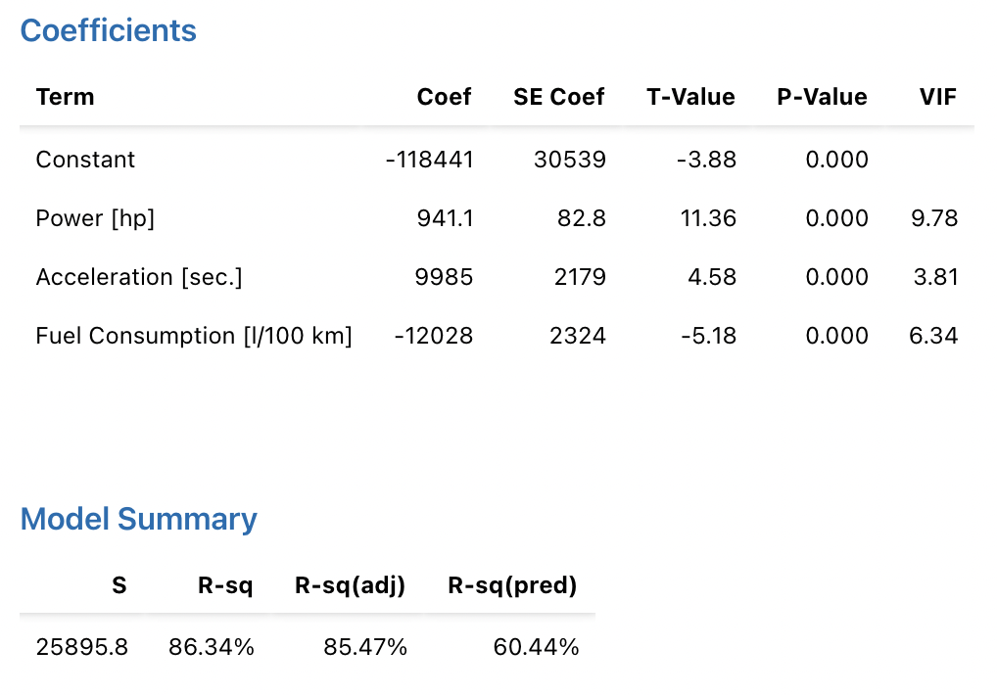
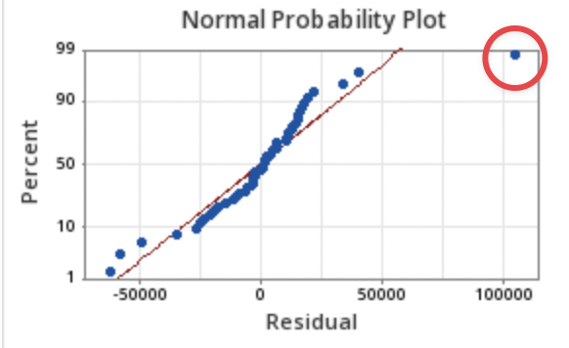
Price – Methodology (1)
Minitab’s Best Subset:
Power, Acceleration, Fuel Consumption
Remove outlier
“ok”, but:

Slide 14
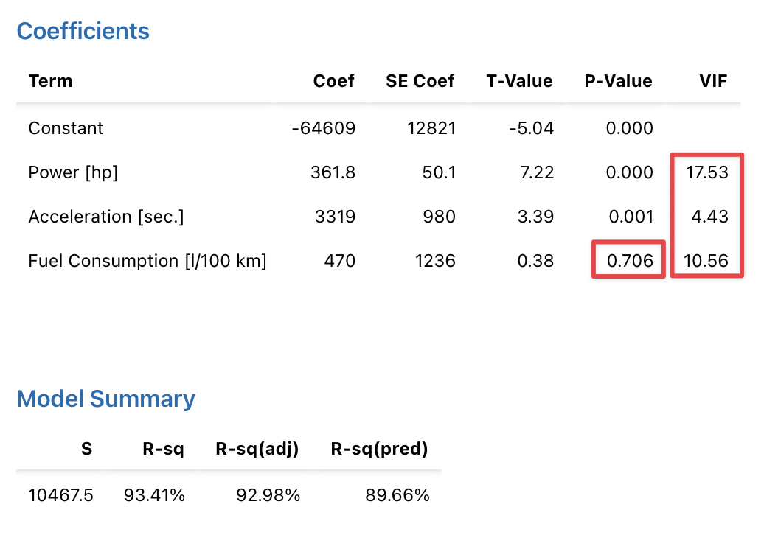
Price – Methodology (2)
Remove non-significant predictor
Standardize predictors
Apply Box-Cox transformation

Slide 15
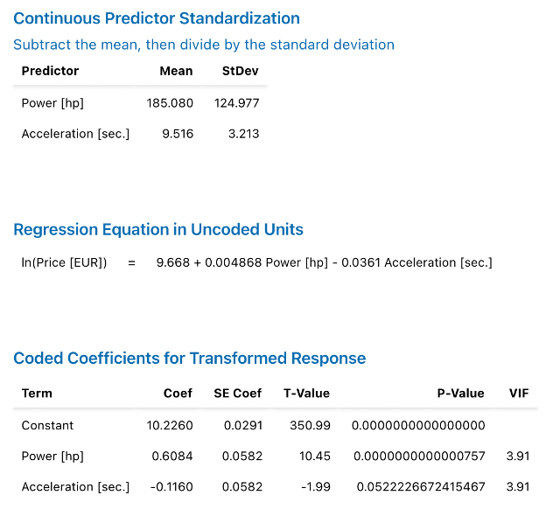
Regression Model – Prize (1)

Slide 16
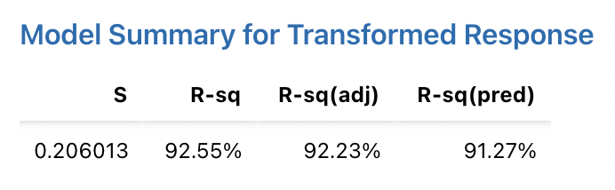
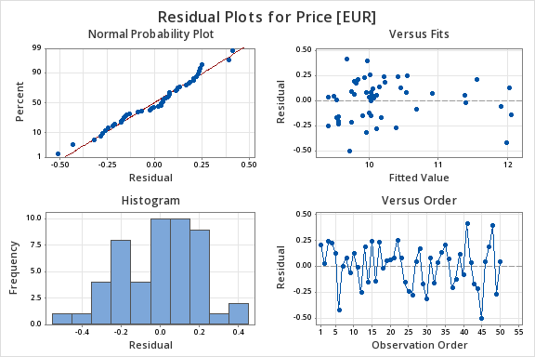
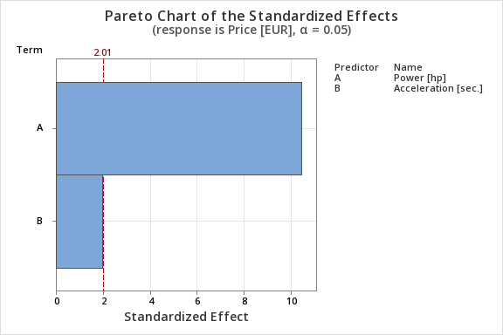
Regression Model – Prize (2)

Slide 17
Models' predictions
 | Acceleration [sec.] | Maximum Speed [km/h] | Fuel Consumption [l/100km] | Price [€]
Car #1 | 12.2 | 185 | 7.2 | 16578
Car #2 | 3.2 | 337 | 22.4 | 237445
Car #3 | 10.5 | 197 | 7.4 | 18942
Car #4 | 10.8 | 192 | 7.2 | 17125
Car #5 | 10.2 | 207 | 7.5 | 22742

Slide 18
Relevant parameters
 | Acceleration [sec.] | Maximum Speed [km/h] | Fuel Consumption [l/100km] | Price [€]
Cylinders
Valves/Cylinder
Displacement [cc]
Turbo
Power [hp]
Max Torque [nm]
Length [mm]
Width [mm]
Height [mm]
Weight [kg]
Trunk Volume [l]
Maximum Speed [km/h]

